Slide 1
5 Things You Didn’t Know Windows Phone Could Do
Yes, I am the guy in Melbourne using Windows Phone

Slide 2
1. Nokia Mix Radio Integration

Slide 3
Find music from:
over 200 countries.
over 3 million global and local artists.
over 20 million tracks.
over a century of recordings.
Notes:
search for an artist
search for a product (such as album, single, or track).
get search suggestions.
get top artists.
get top products.
get products by an artist.
get new releases.
get a list of genres.
get artist details (such as name, country, location, genre, and thumbnails).
get product details (such as name, category, genre, performers, prize, and thumbnails)
get artist recommendations.
get product recommendations.
get artists around a location.
get a list of available mixes.
get the user’s play history.
get the user’s top artists for the week.

Slide 4
2. Amazing Cameras

Slide 5
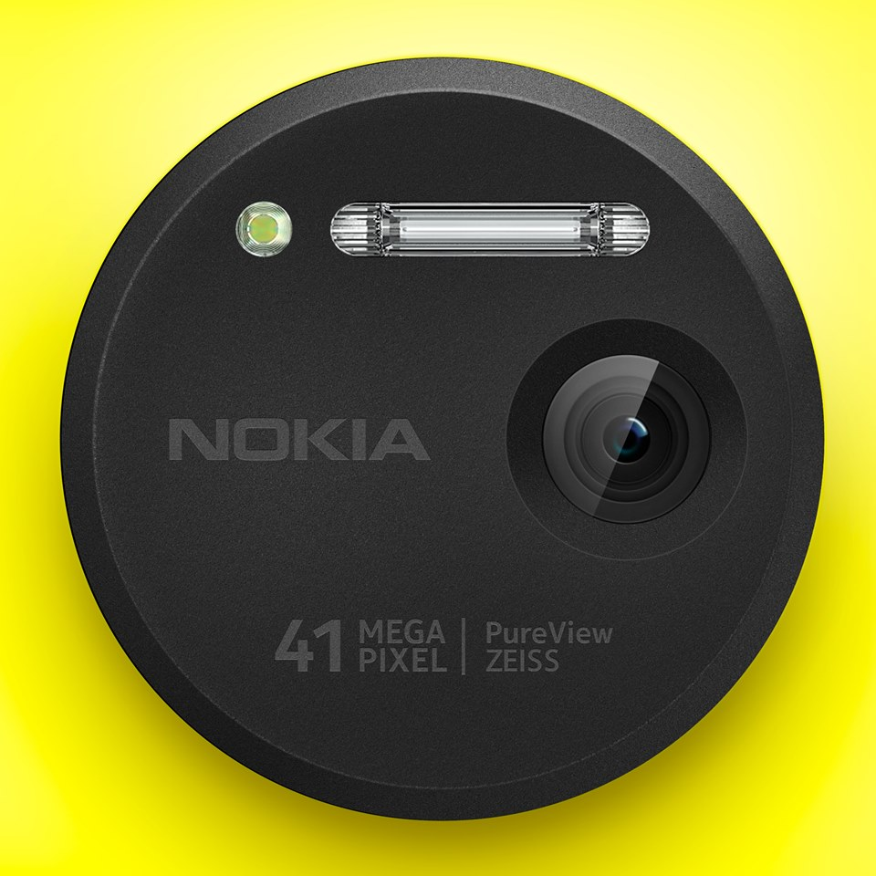
+ Nokia Imaging SDK
Notes:
Partial jpeg decoding
Over 50 filters, effects, and enhancements
Crop, resize, rotate, and undo

Slide 7
3. Custom URI Schemes

Slide 8
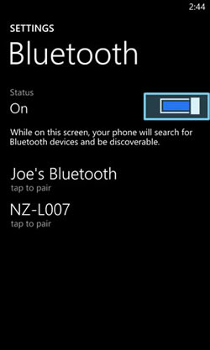
ms-settings-airplanemode:
ms-settings-bluetooth:
ms-settings-cellular:
ms-settings-emailandaccounts:
ms-settings-location:
ms-settings-lock:
ms-settings-power:
ms-settings-screenrotation:
Launcher.LaunchUriAsync(new Uri(“ms-settings-bluetooth:”));

Slide 9
4. Magic Powers

Slide 10
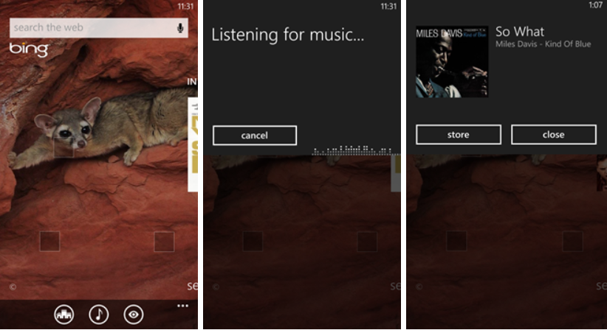

Slide 12
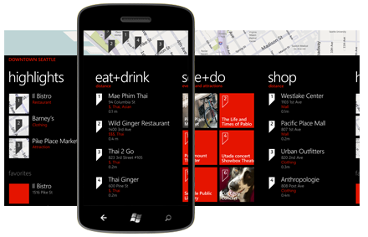

Slide 13
5. Make You Rich (well, sort of)

